Slide 1


ANTI-RAGGING MASS BUNK
Ankur
Kumari

Slide 2
Agenda
Introduction
Problem Statement
Solution Overview
Email Reporting
E-Counseling
Awareness

Slide 3

Introduction
This is a judgment-free space for students to unite against campus ragging and harassment. We're here to provide counseling support, legal advice, campus policy guidance and any other resources you need.
You are not alone. We stand together against ragging, and harassment, and we will make campuses safer for all students.
3

Slide 4
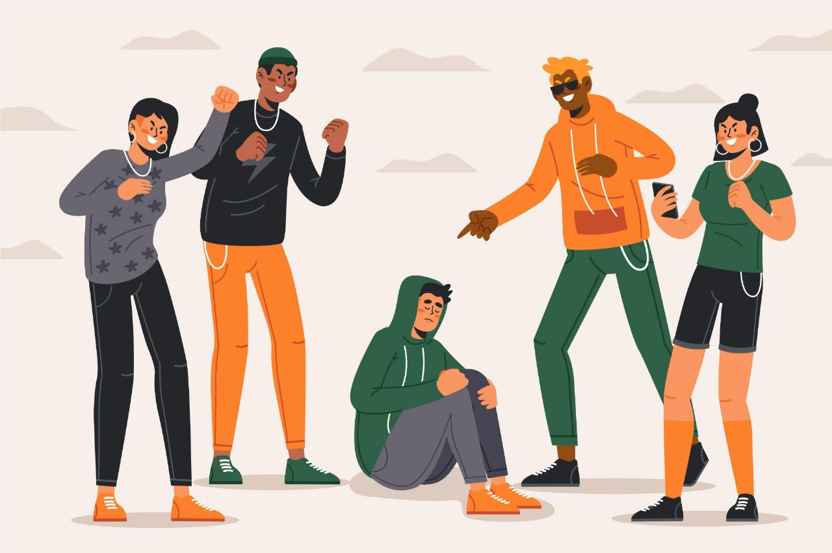
“Ragging and forced bunking still occur on campuses.”
4

Slide 5

Solution Overview Our online platform provides support
Anonymous reporting to college
Counseling and peer support
Resources like legal advice and policy guidance
Approach
Layer 1 - Email to college Dean
Layer 2 - Counselor Support
Layer 3 - Student Support
5

Slide 6



Approach
Email to college Dean
Creates a record of the complaint
Bypasses bureaucracy of formal procedures
Quick and easy way to report misconduct
Can be anonymous
Counselor Support
Prevents Escalation: Early intervention curbs long-term effects.
Strengthened Resilience: Equips coping strategies for stress.
Fosters Unity: Peer support builds community.
Student Support
Helps students process and recover
Reduces chances of dropping out
Empowers students to speak out
Fosters community and support
Shows the college cares about student wellbeing
6

Slide 7

Email Reporting Direct email to college administration
Creates record of complaint
Gets attention of authority figures
Easy anonymous reporting
7

Slide 8
Emailing
Creates record of complaint
Complaints can be structured with this feature.
Details such as the complaint type, date, and time are accurately recorded.
Gets attention of authority figures
Individuals can submit the issue.
This can help escalate the matter to individuals who have the power to take action effectively.
Easy anonymous reporting
Individuals can submit complaints or reports anonymously.
It ensures confidentiality and encourages individuals.
8

Slide 9

E-Counseling Healing and empowerment
Professional counseling
Peer support groups
Confidence building workshops
9

Slide 10

Awareness Together we can make a difference.
Join the movement
Speak up safely
Support each other
10

Slide 11
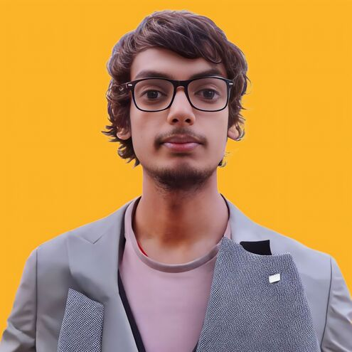
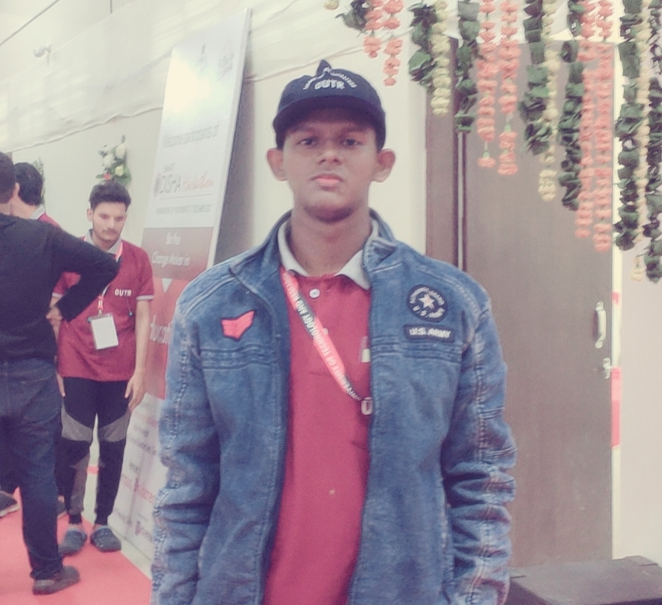
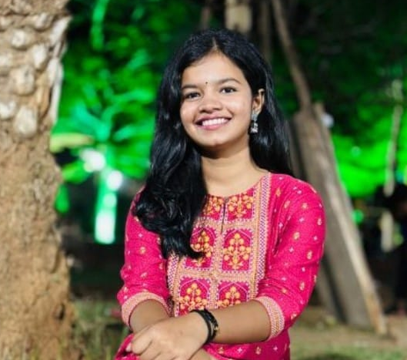
Meet our team
Sudhanshu Kumar
CSE Student
LeetCode Enthusiast
Aniketa Das
Ankur Kumari
CSE Student
Problem Solver
CSE Student
Analizer
11

Slide 12


Thank you
anti_ragging@yahoo.com
https://anti-ragging.netlify.app

